Slide 1
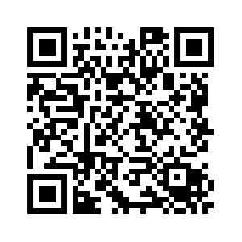
Excuse Note Submission
You now send your excuse note electronically to the attendance department.
Using your phone, take a picture of your excuse/doctor’s note.
Send as an attachment to AttendanceEHS@FortBendisd.gov
Add your name to the subject line.
If you leave the subject line blank, your email will be rejected.
Note: Hold on to your excuse note until your absence has been excused.
Check your attendance daily using your Skyward app.
See your Attendance Clerk if you have any questions or problems.
A-G – Ms. Najera
H-O– Ms. Escobedo
P-Z – Ms. Clayton-Witmer

